Slide 1
SOLVEDOKU

Slide 2
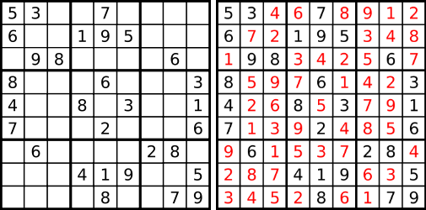
Introduction
SOLVEDOKU solves Sudoku puzzles using image recognition
SOLVEDOKU offers several benefits for the user
Allows for a quick solution to a Sudoku puzzle
Offers an easier solution finder than a text input Sudoku solver

Slide 3
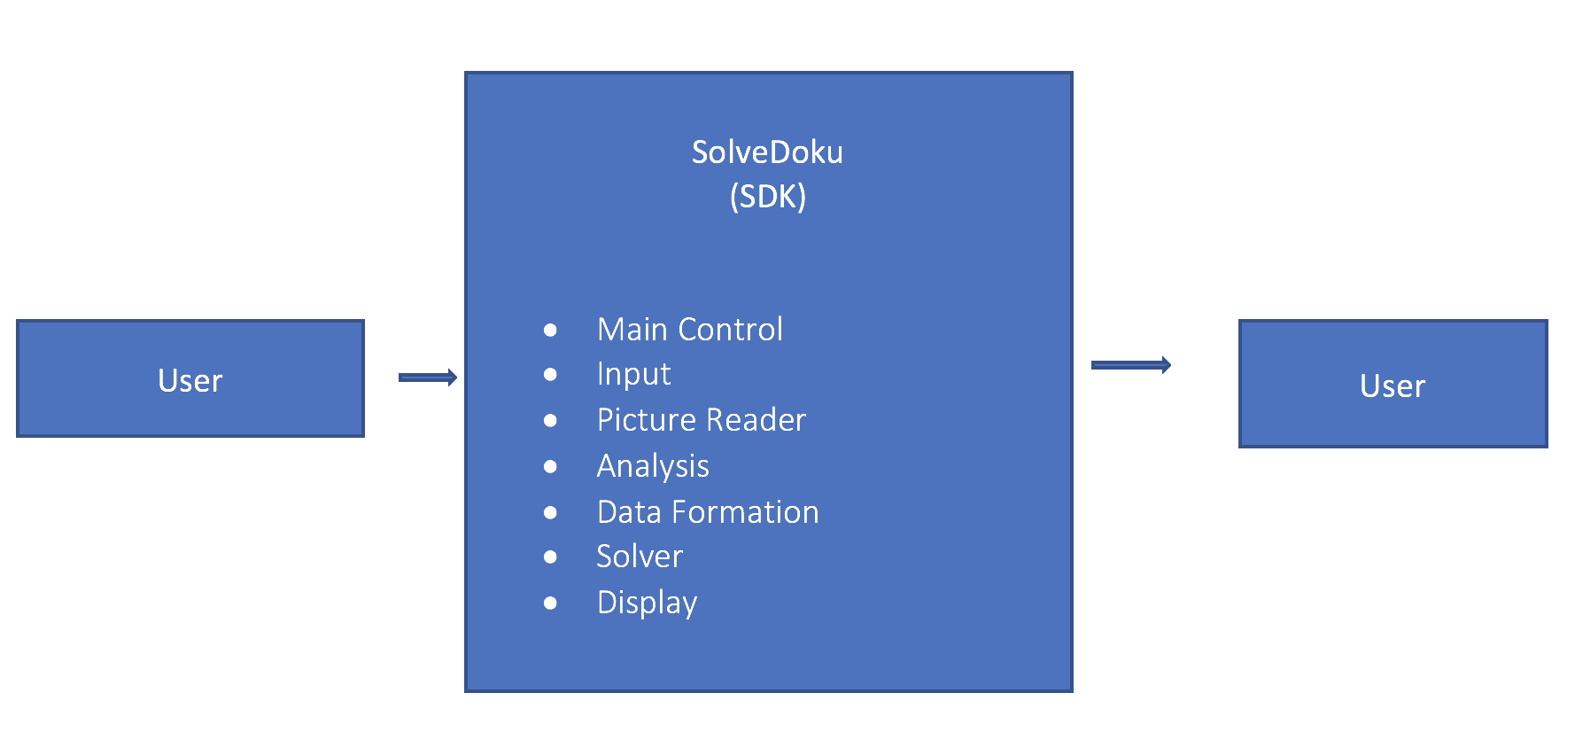
DFD LEVEL 0

Slide 4
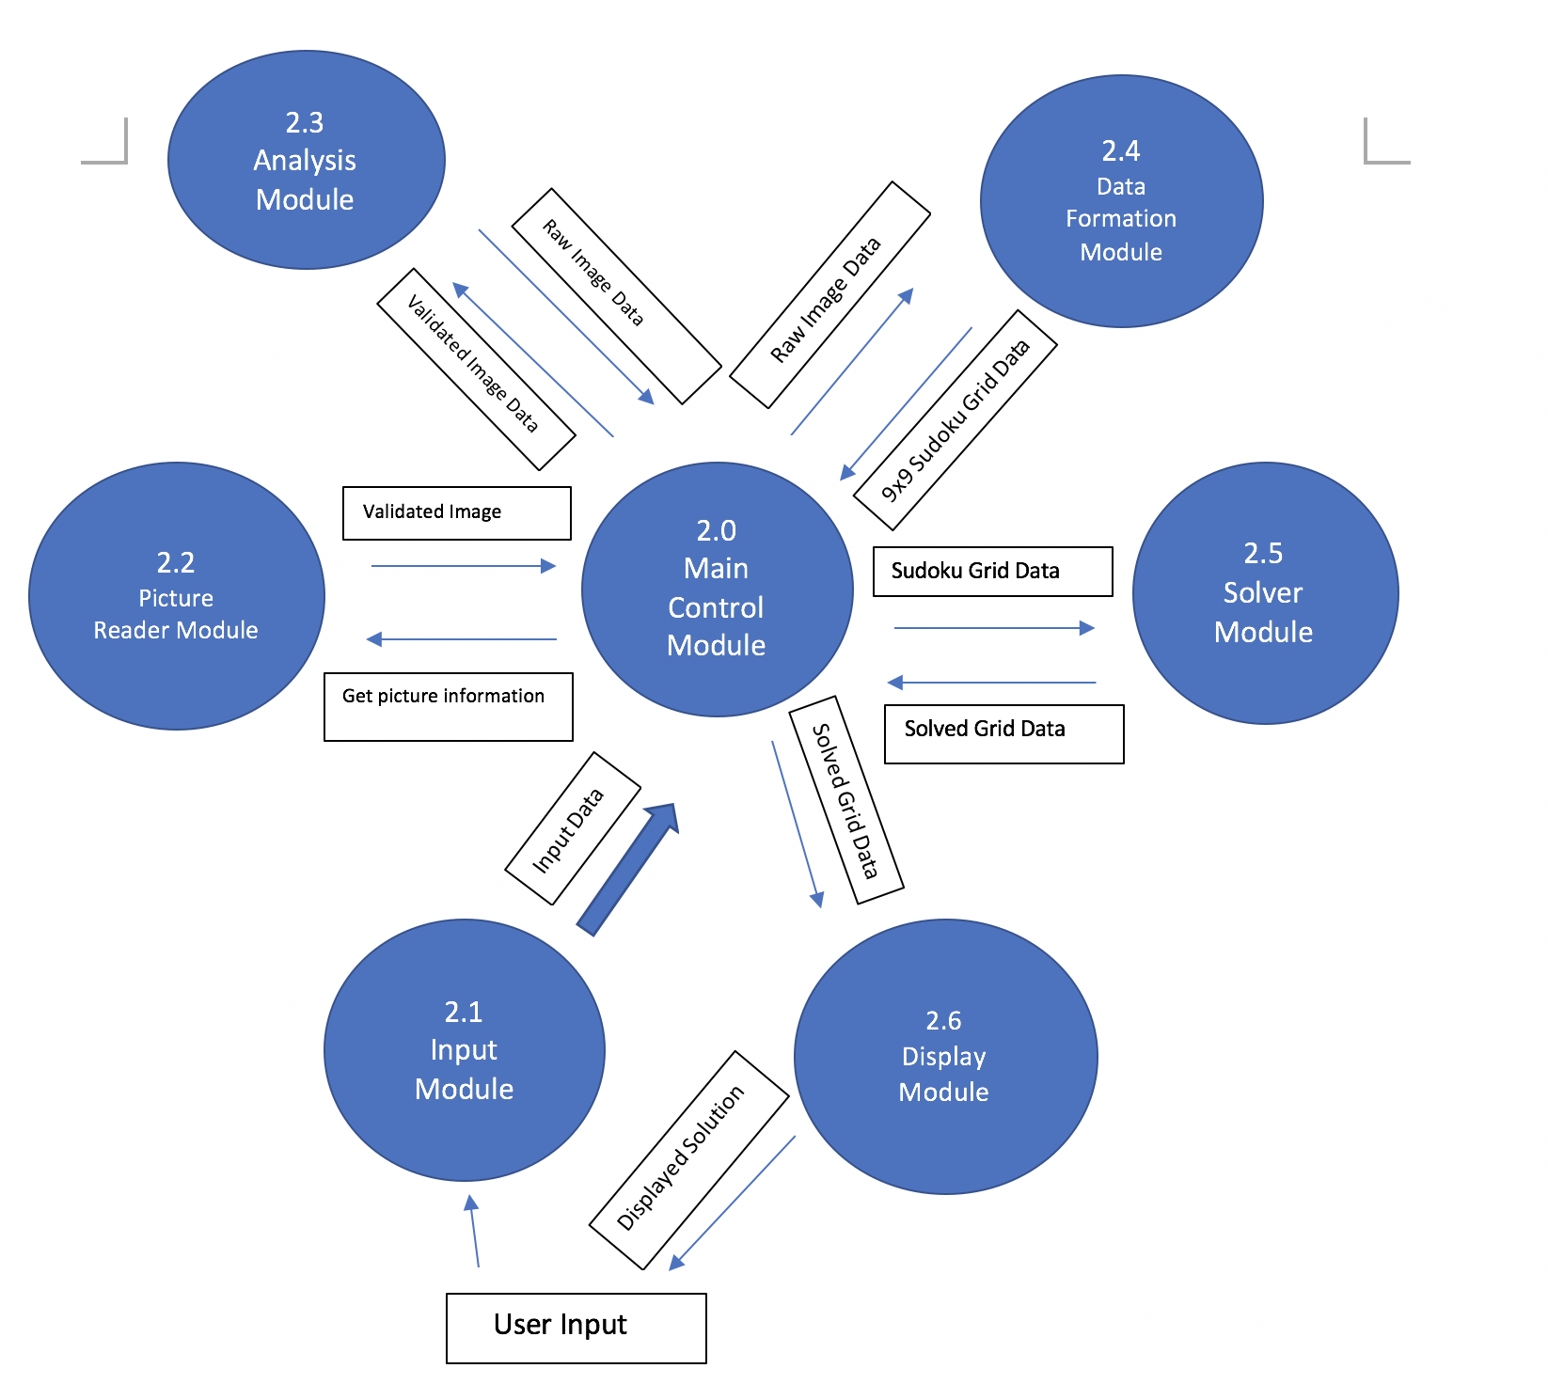
DFD LEVEL 1

Slide 5
Input module (IM)

Slide 6
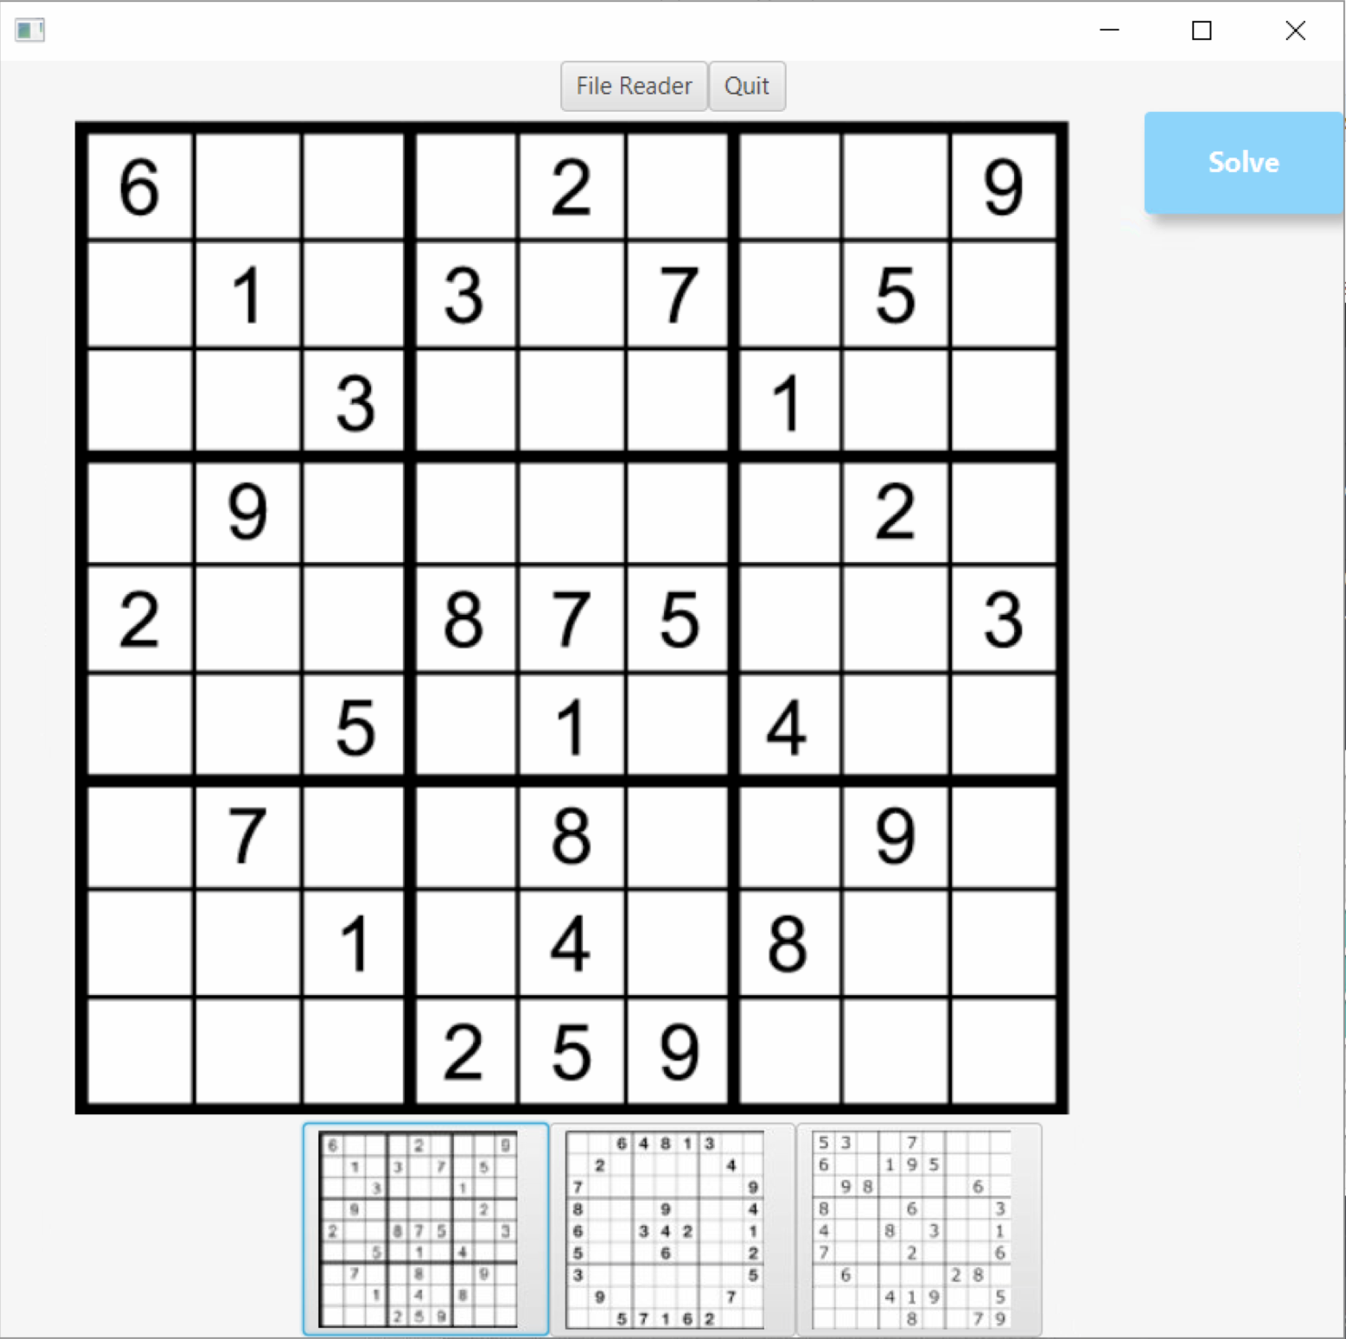
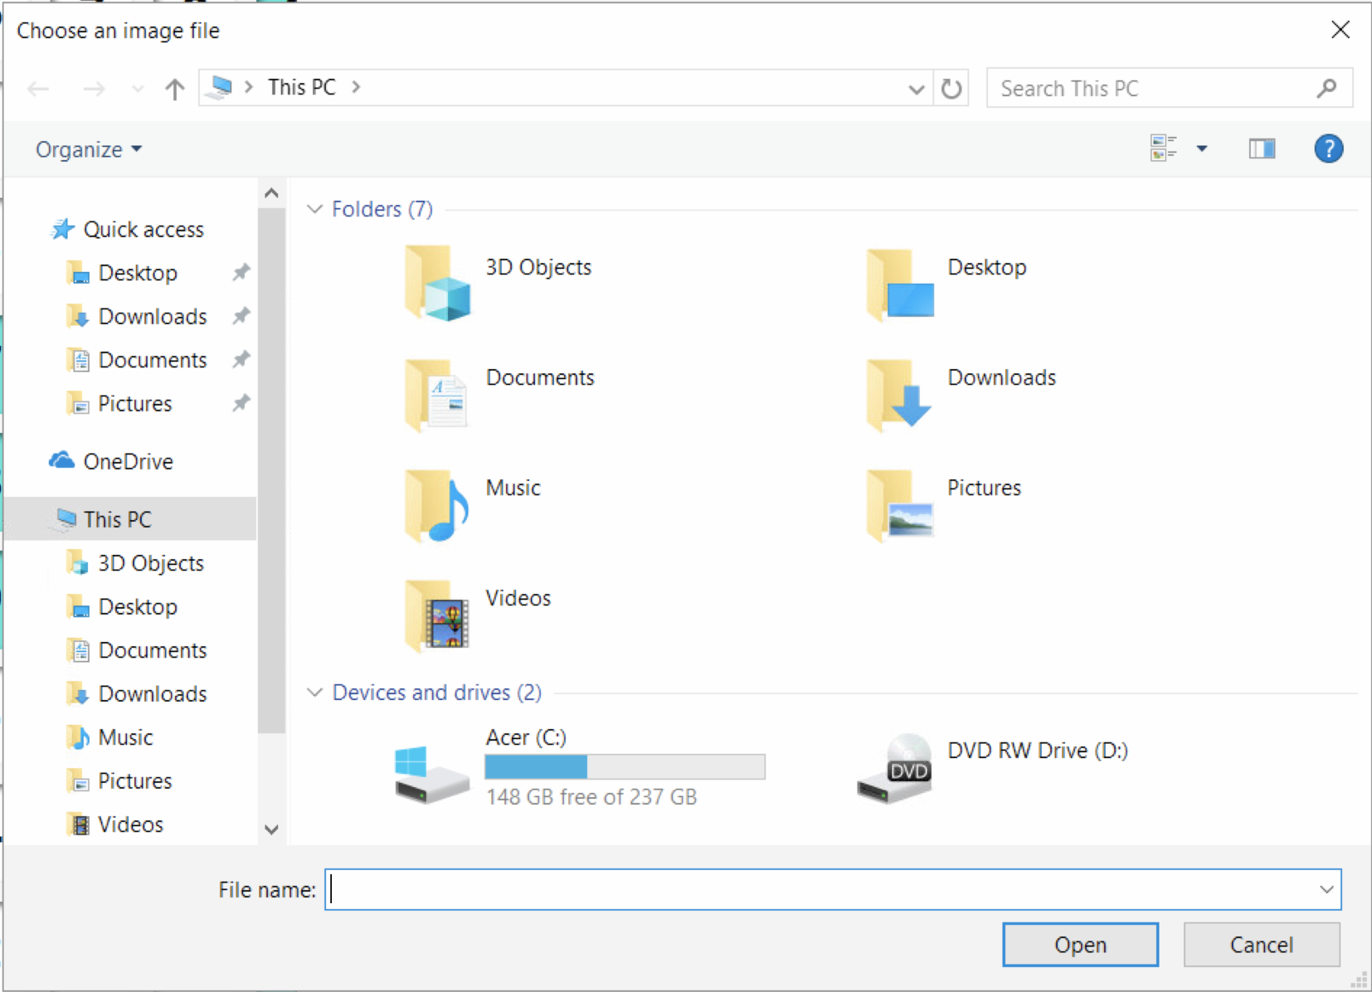
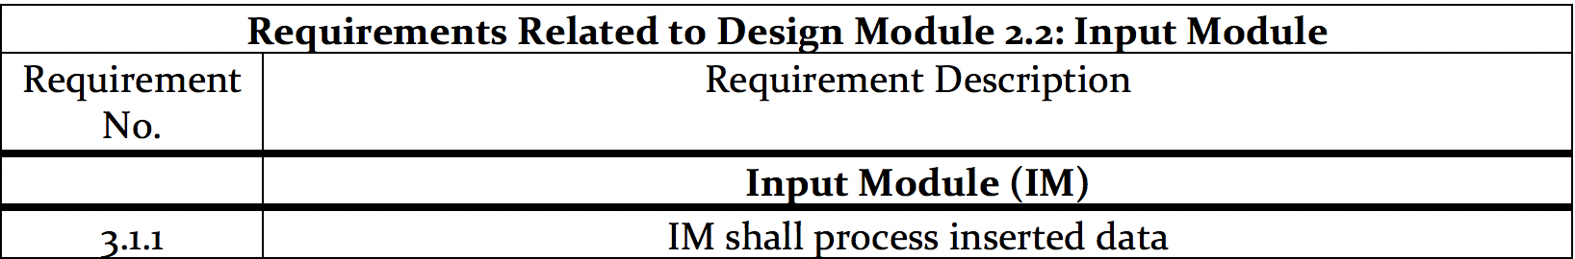
Input Module

Slide 7
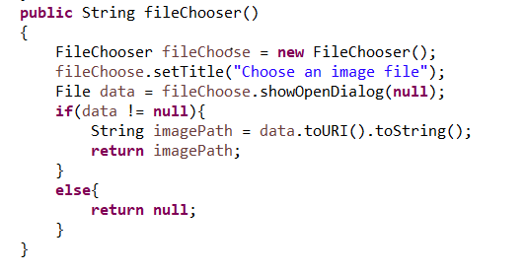
Input module implementation

Slide 8
Picture reader module (PRM)

Slide 9
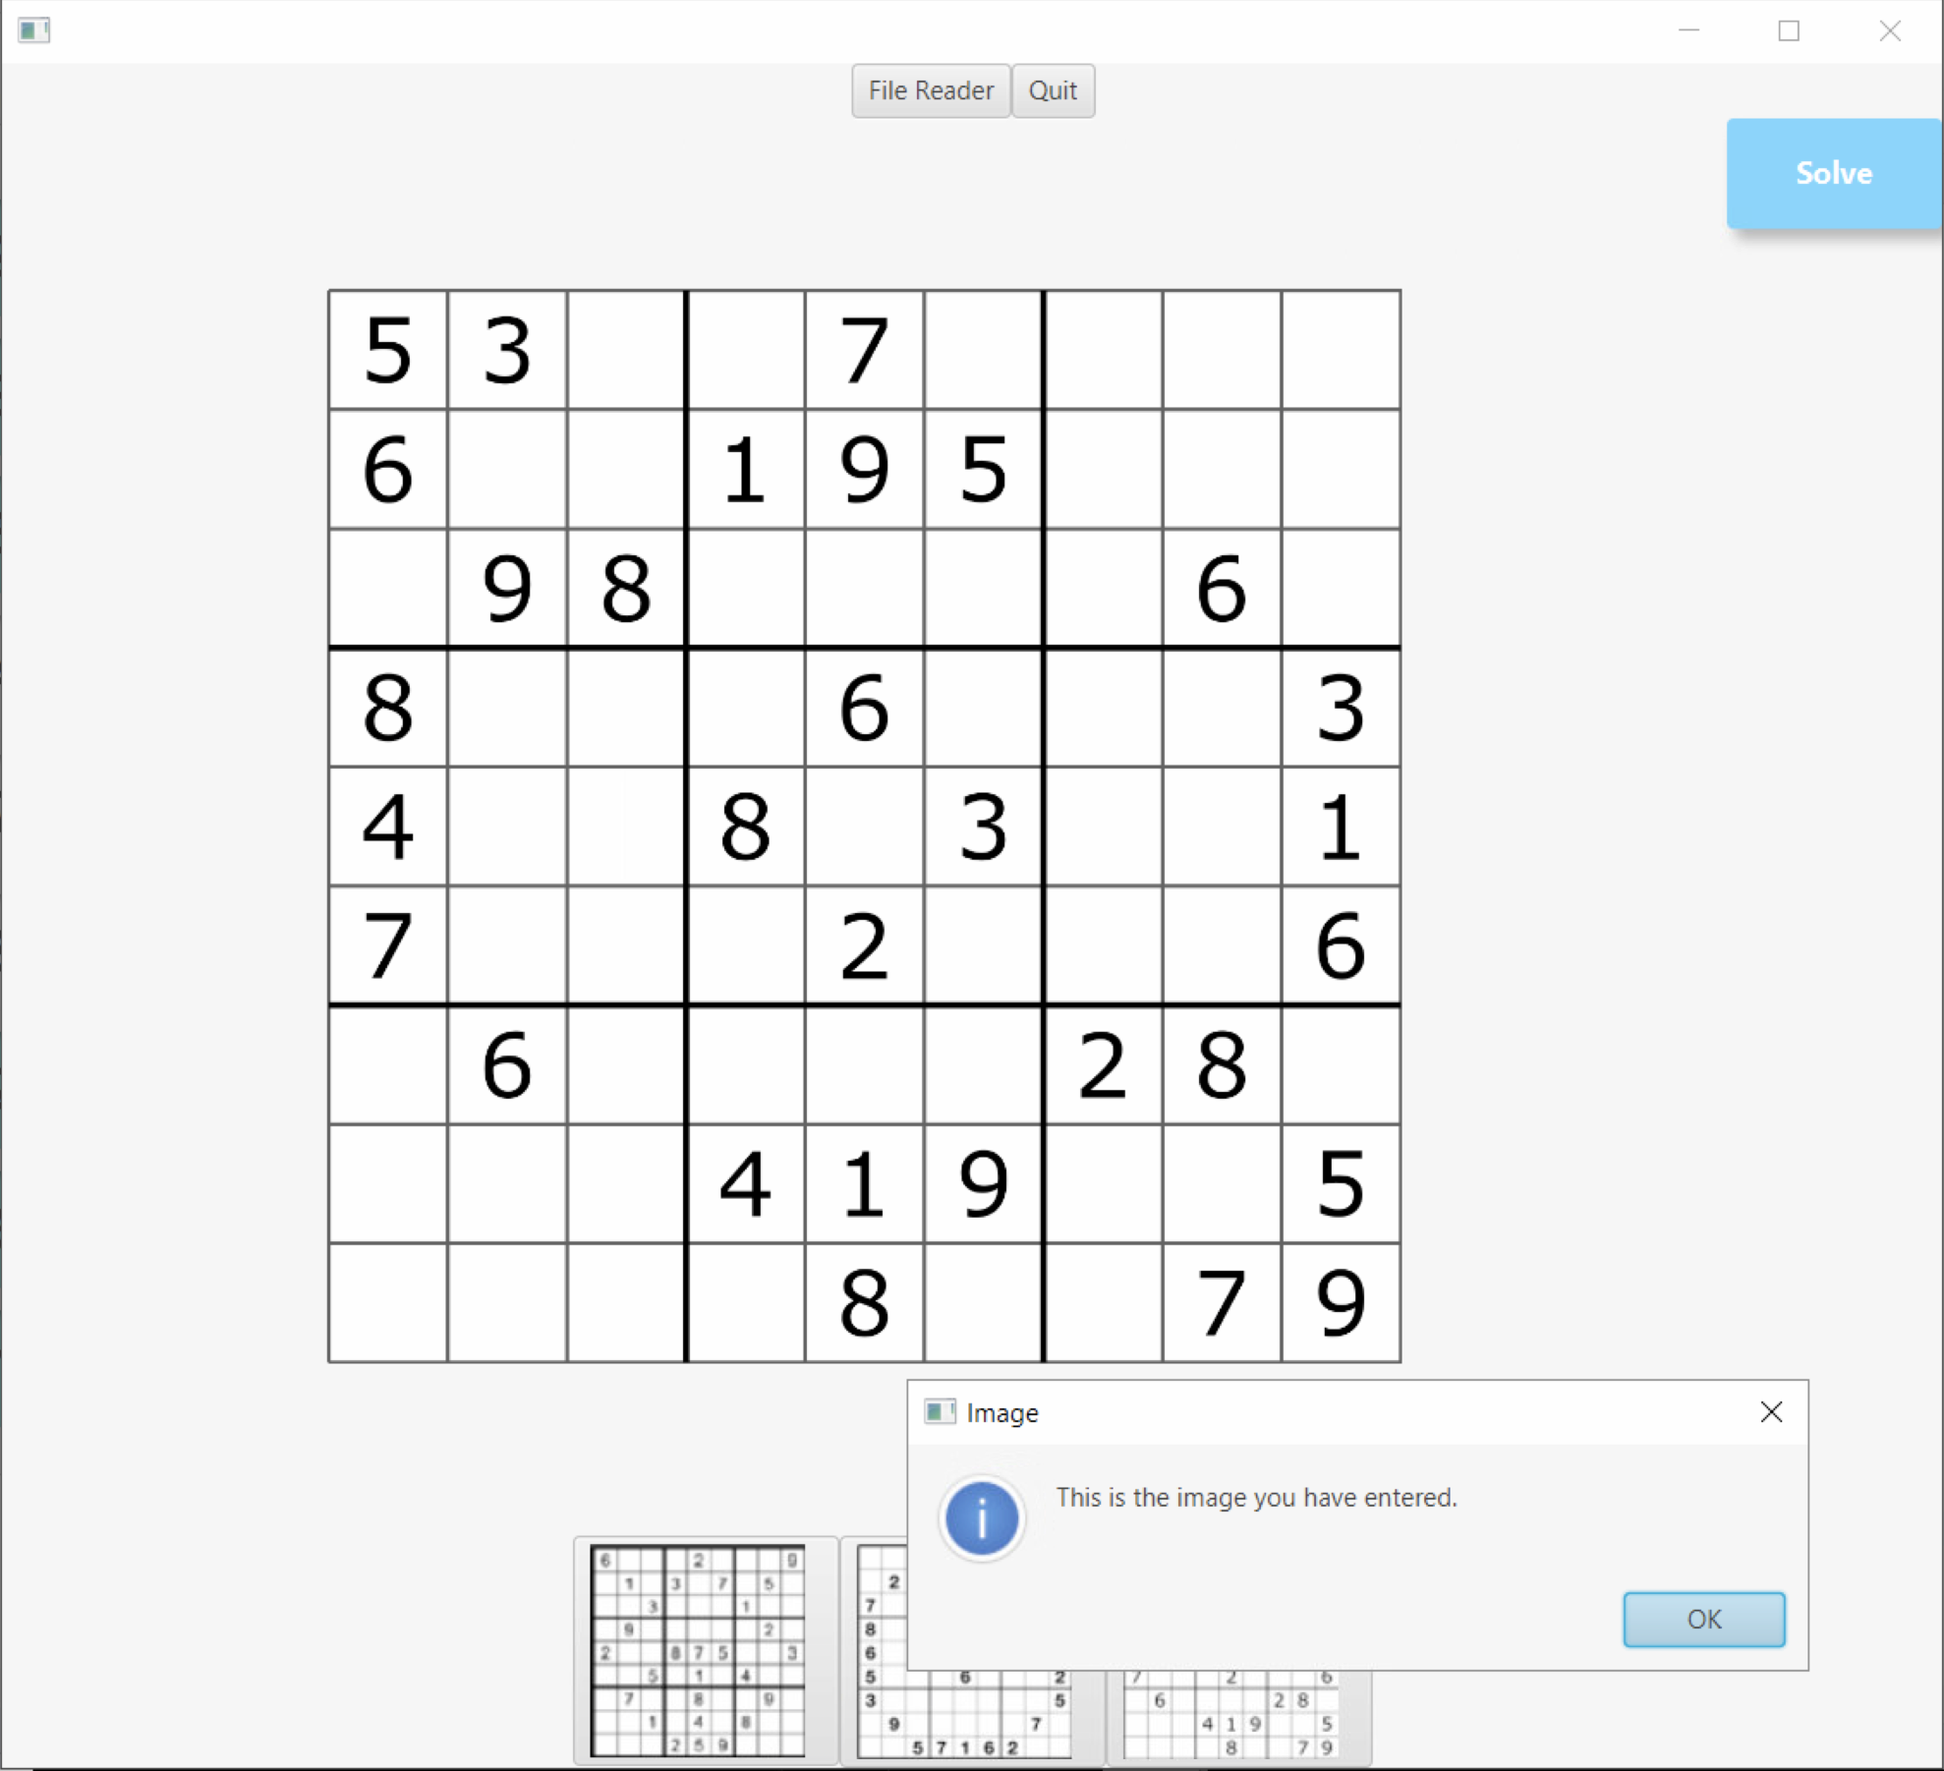
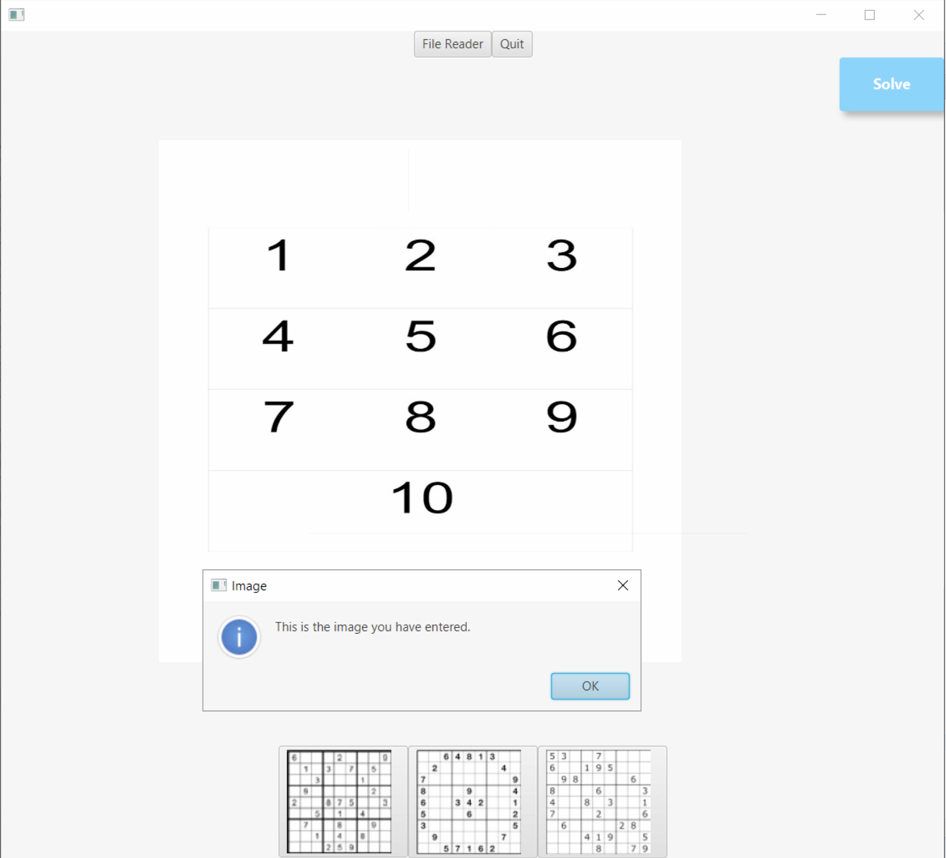
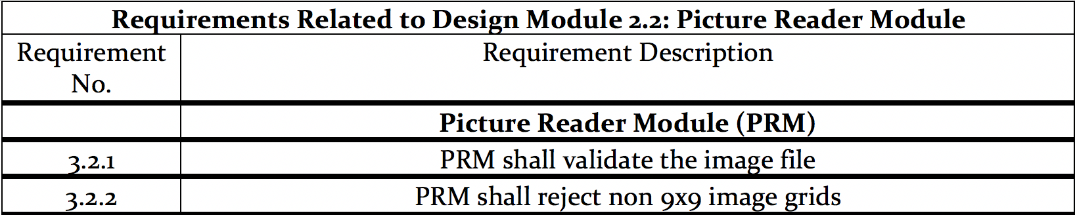
Picture Reader Module

Slide 10
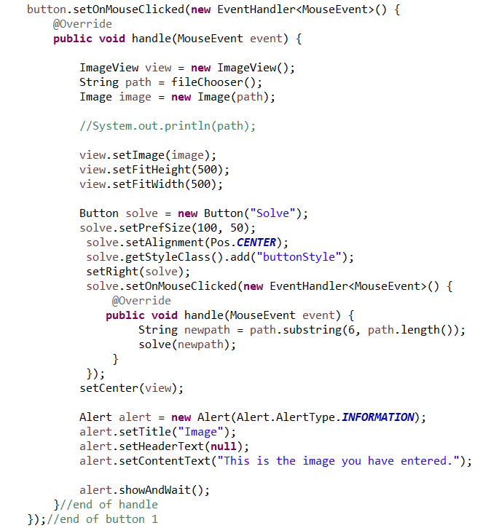
Picture reader module implementation

Slide 11
Analysis and data formulation module (AM) (DFM)

Slide 12
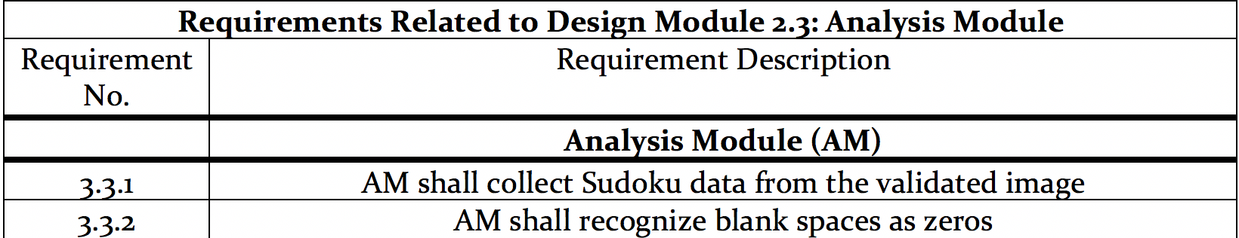
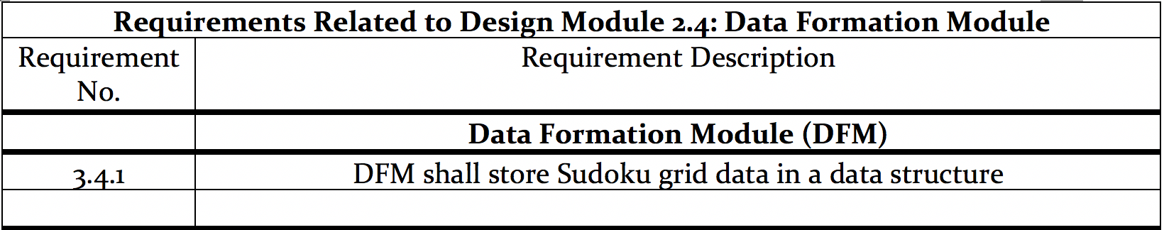
Analysis and data formulation module

Slide 13
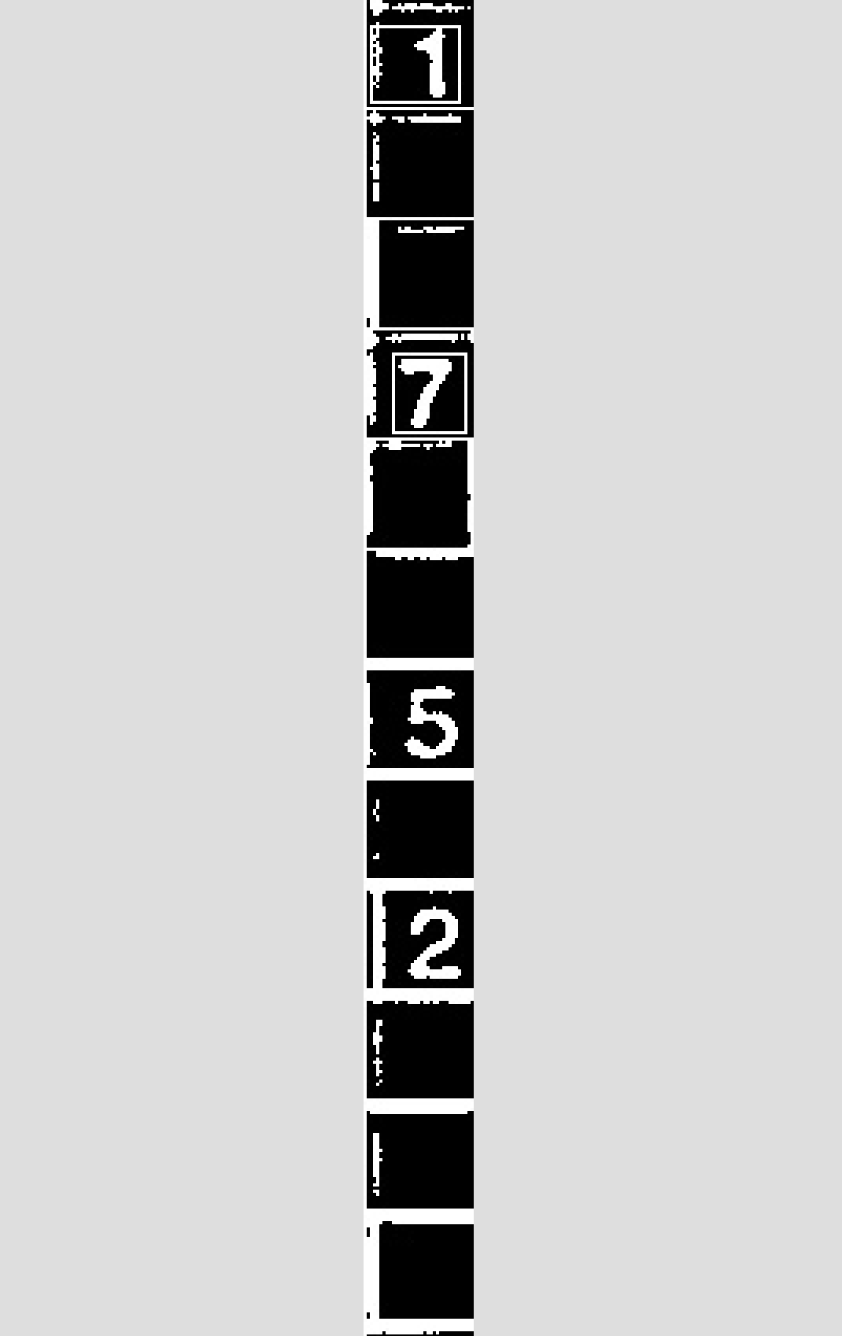
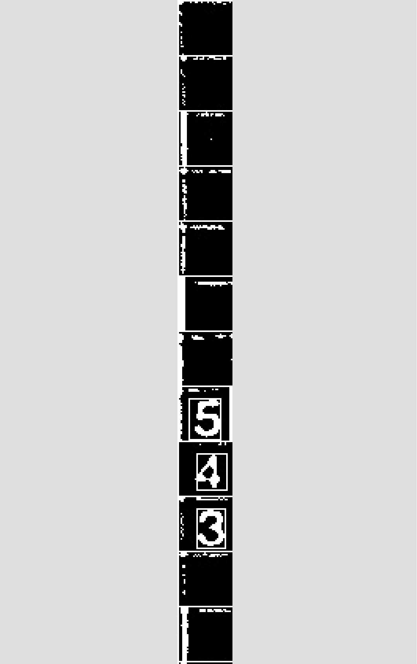
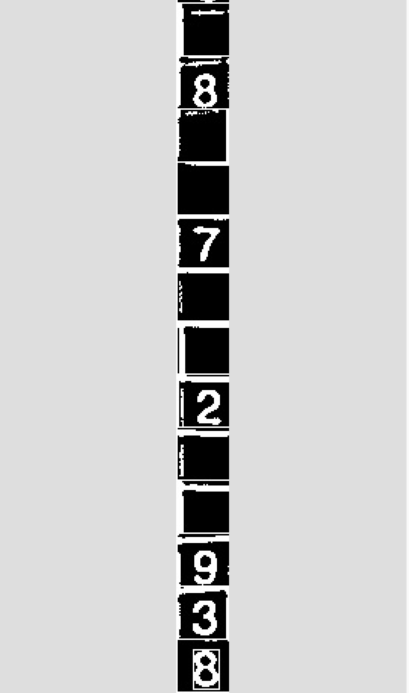
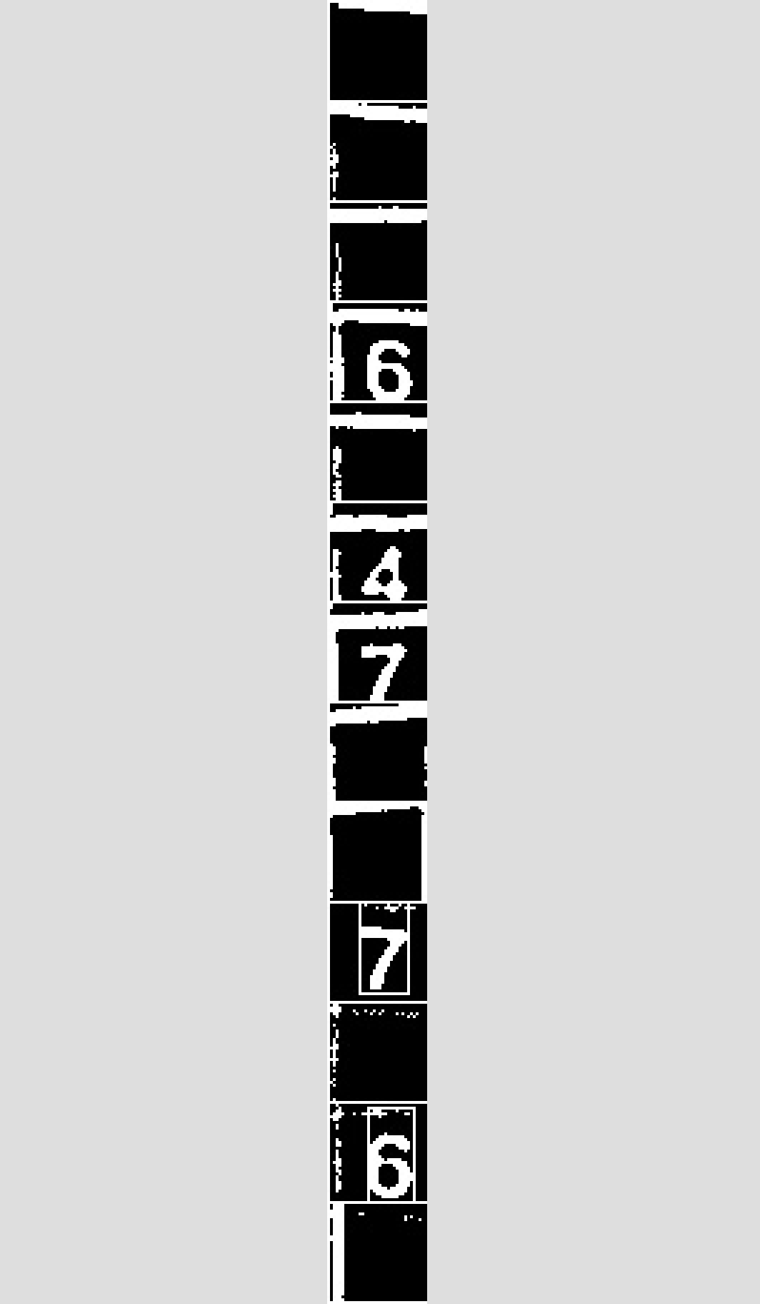
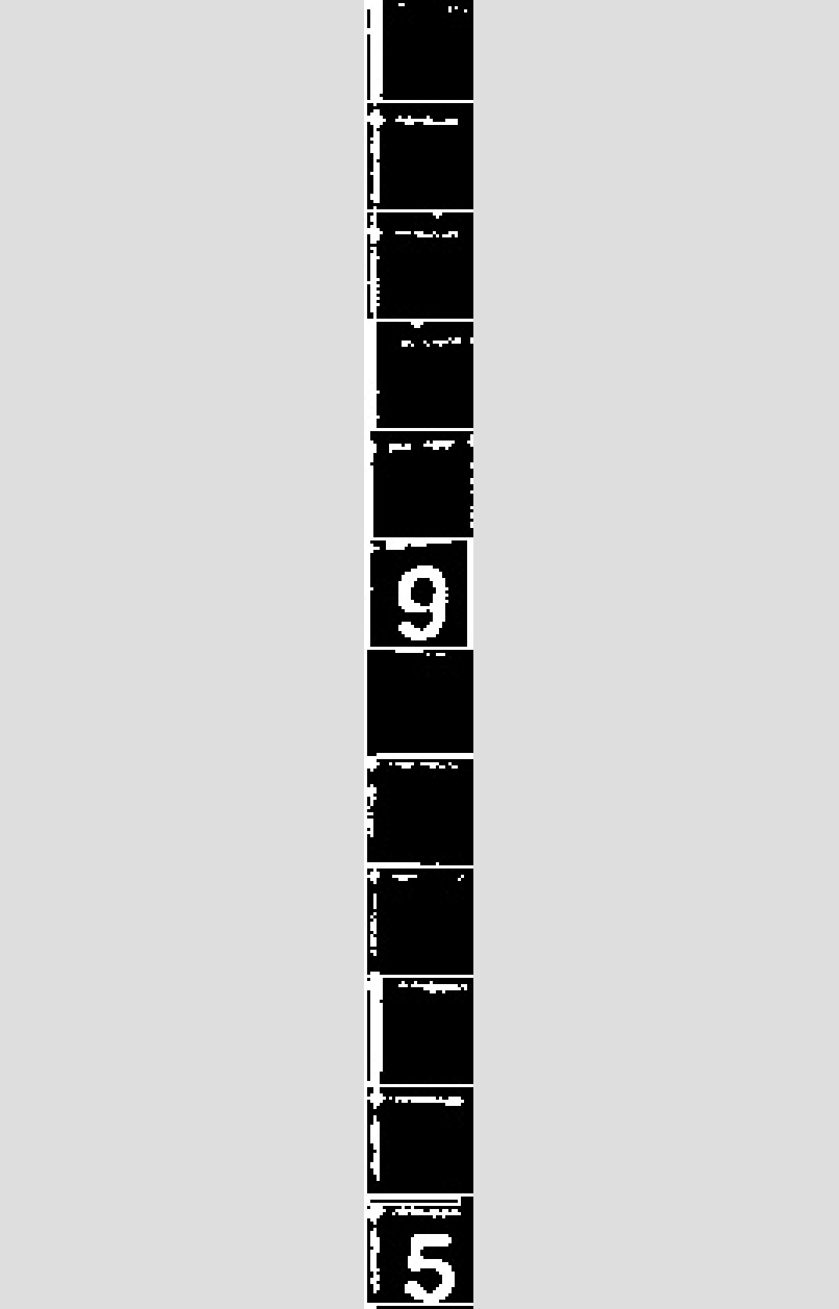
Analysis and data formulation module cont.

Slide 14
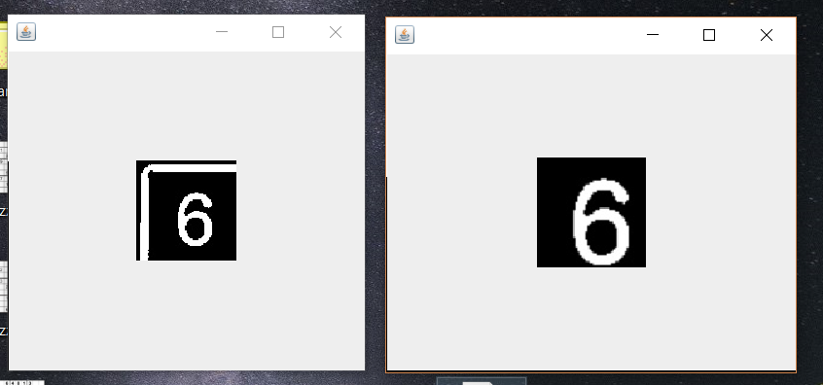
Analysis and data formulation module cont.

Slide 15
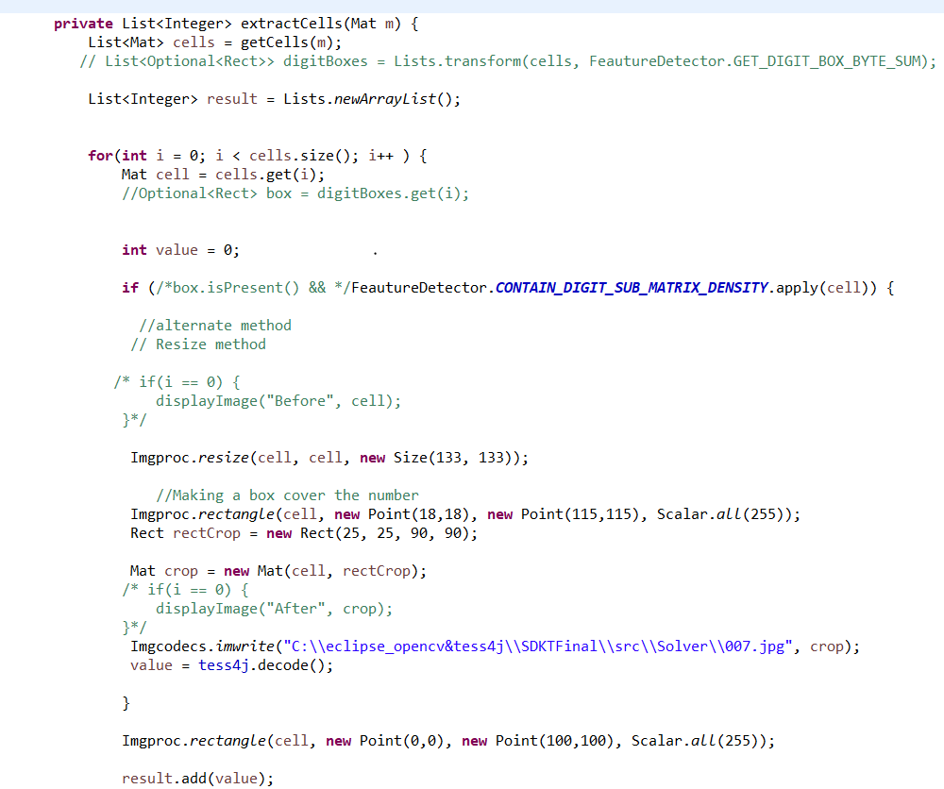
Analysis and data formulation implementation

Slide 16
Solver Module (SM)

Slide 17
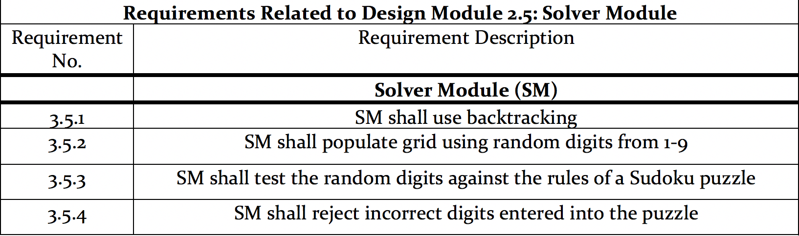
Solver Module

Slide 18
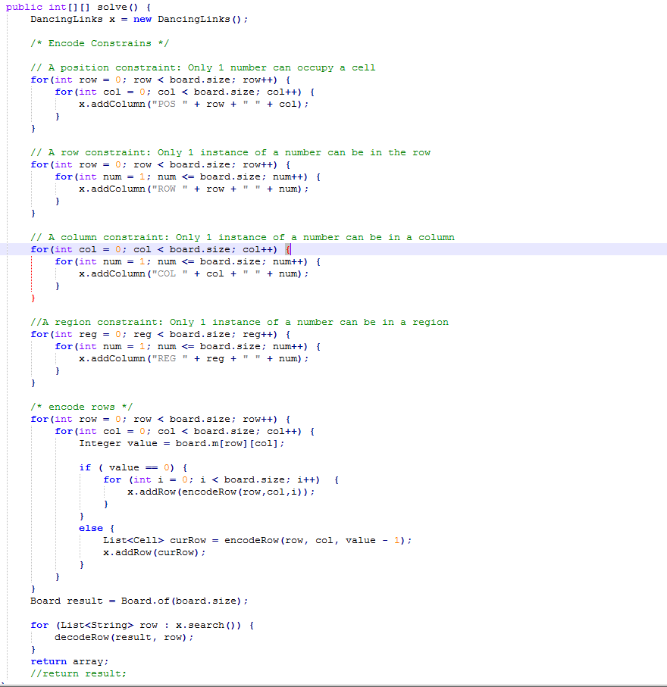
Solver Module cont.

Slide 19
Display module (DM)

Slide 20
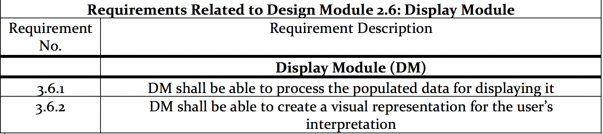
Display Module

Slide 21
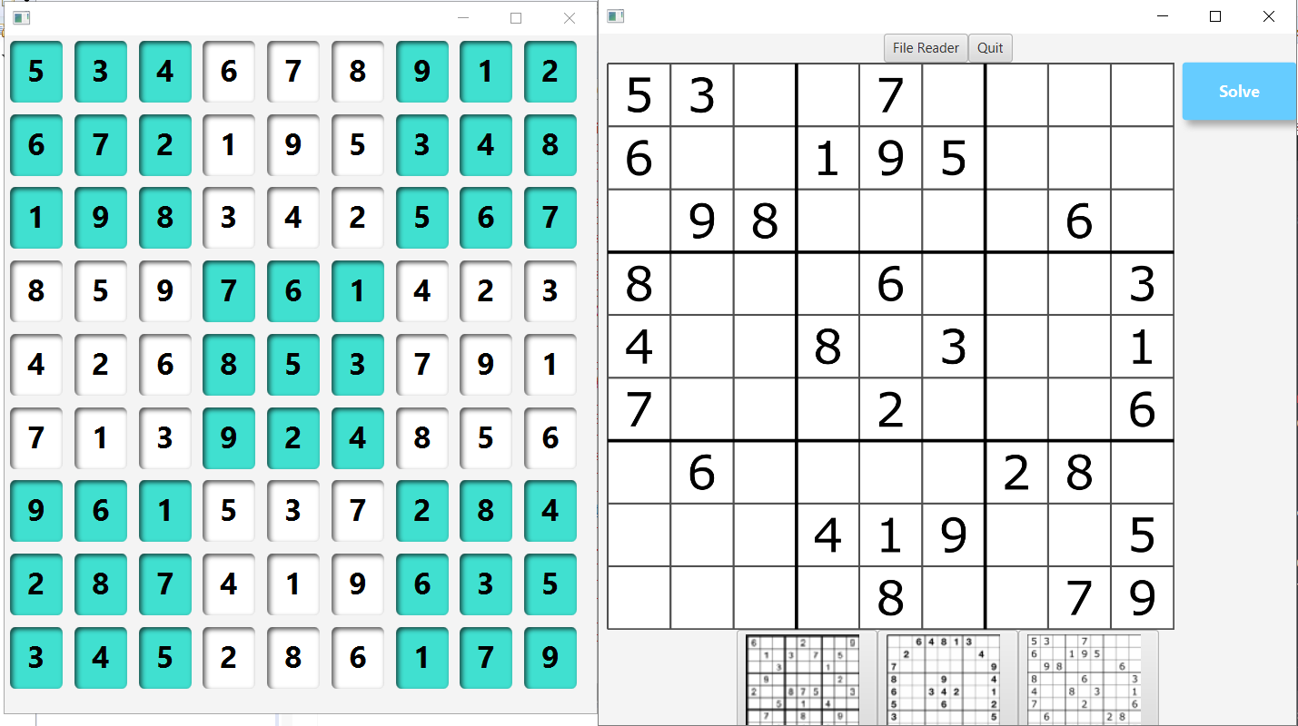
Display module

Slide 22
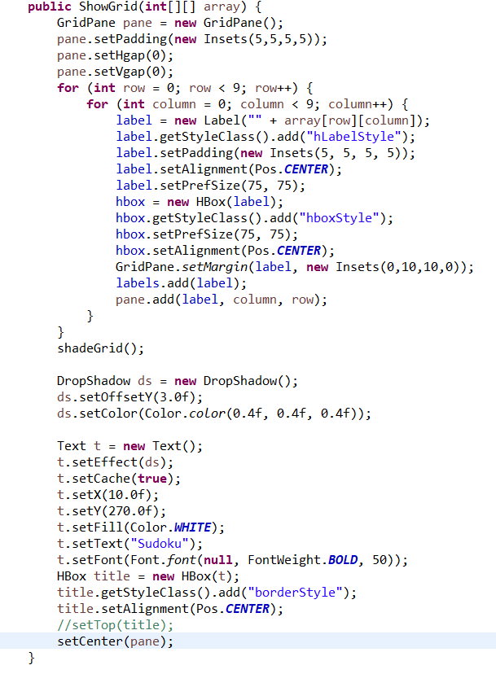
Display module implementation

Slide 23
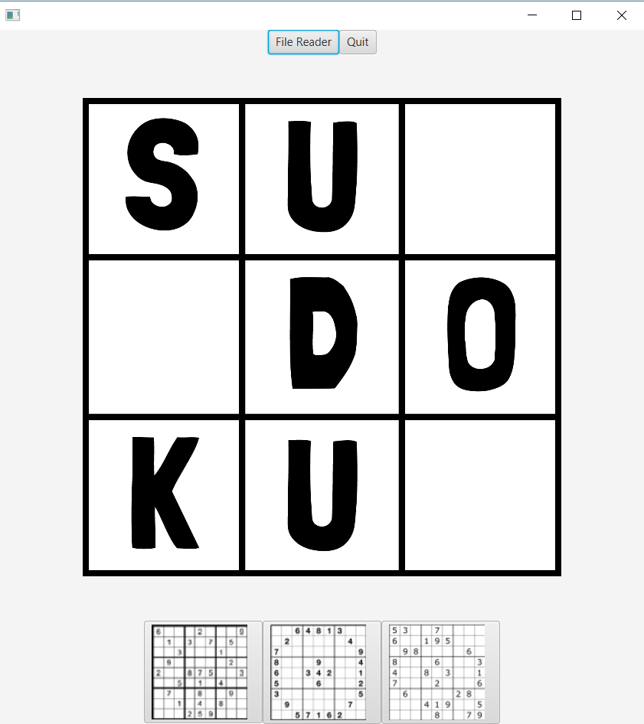
Main Control Module
Provides mechanisms (mainly buttons) to control the features.

Slide 24
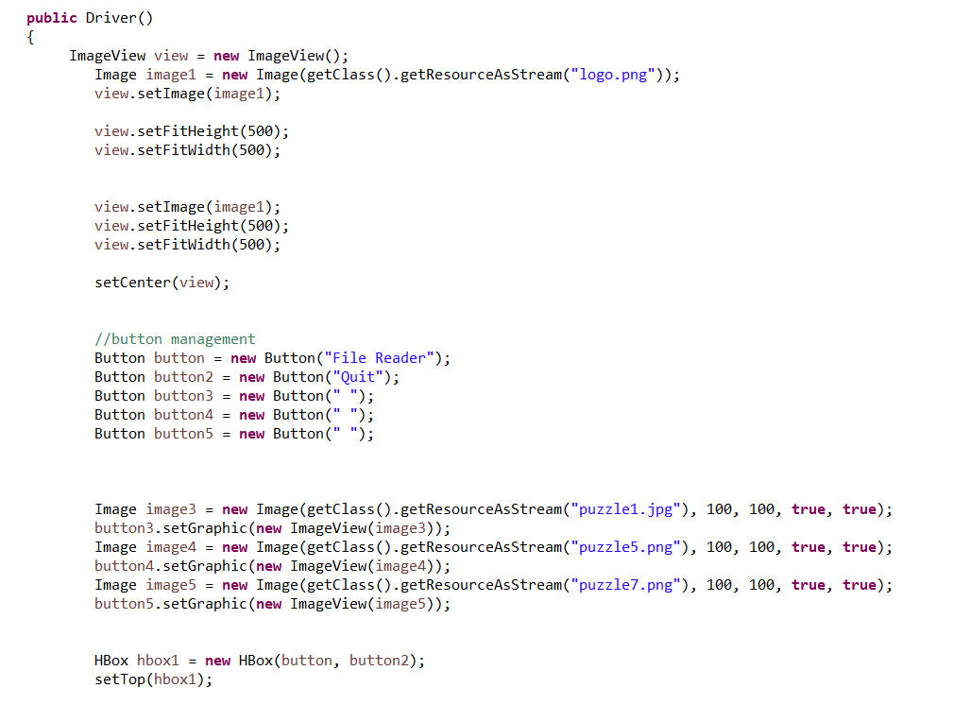
Main Control implementation

